Slide 1
Customer Proprietary Network Information (CPNI)

Slide 2
The CPNI (Customer Proprietary Network Information ) security procedure is in place to protect the customer and the privacy and integrity of their Altice account and services.
Within Dart in our ‘’Secure Transaction Authentication Tool’’ (Stat Tool), you will notice the CPNI verification and the Authentication method. Depending on the action required by the customer one method or the other (CPNI or Authentication) might be needed, in order to determine which should be used you can refer to CPNI Matrix article in KDB.
Please Be Aware!
We have seen many scenarios where impostors posting as customers and Optimum store employees. The individuals are asking customer equipment information with the excuses that their old equipment caught fire and was placed in the garbage.
Do not fall for it. Even if CPNI has been verified, a store employee will never need a Contact Center Agent to provide equipment serial numbers.

Slide 3
CPNI Procedure
Depending on the option that’s being chosen in the STAT tool, this will tell you if you need to follow a CPNI or an Authentication procedure. When a customer has Voice/Phone service in the account the Stat tool will automatically change from Authentication method to CPNI, this is because of the United State Law that protect customer’s information from fraud. You can also look at the article in KDB “CPNI Security Matrix and Steps (STAT)”.

Slide 4
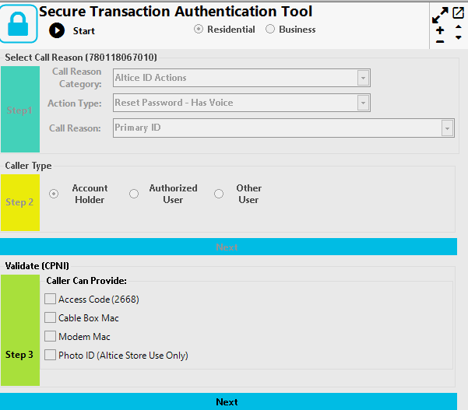
CPNI Methods
When CPNI is needed to perform the action requested by the customer, you can only use one of these three methods:
Cable Box Mac
Modem Mac
Access Code

Slide 5
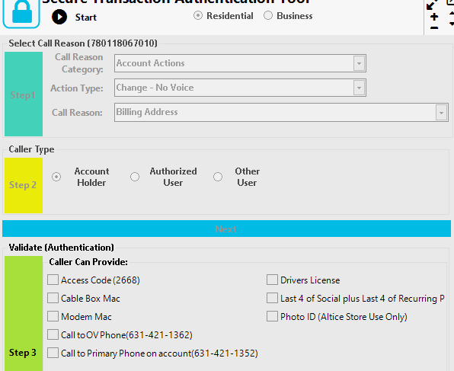
Authentication Methods.
When Authentication is needed to perform the action requested by the customer, you can only use one of these methods:
Cable Box Mac
Modem Mac
Access Code
last 4 of Social plus Last 4-digits of Recurring Payment Method
Keep in mind that we are not allowed to use any Call OV option nor Drivers license.

Slide 6
CPNI Security Verification Failure
If the necessary information can’t be verified or any CPNI/Authentication step can’t be done:
No account changes can be made.
The customer must be informed to contact back when the information can be verified.
If there is account holder’s name on the account but the person in the chat is not the account holder and is not listed as Authorized user, advise the other user to contact our customer service department by phone with the account holder to add him/her as Authorized user or the account holder can contact us via chat to proceed with this request and CPNI must be verified first.

Slide 7
Let’s Practice
1- Mr. Smith forgot his Optimum ID password and he is contacting us to reset it, for security verification we perform CPNI. He has Voice service on his account. Select the correct process for this scenario.
Confirm the last 4 digits of the Social plus last 4 digits of recurring payment method.
Verify the Modem Mac Address (CMAC).
Resetting Optimum ID password does not require any security verification.
A and C are correct.
2- Jhon Carter is an Optimum store manager, he mentioned that he needs to obtain the Modem Mac Address of a customer’s account to add a new promotion. He brings you the name, address and telephone number to open the correct account. We should:
As he is an Optimum representative, we should open the account and bring the Modem Mac Number without performing CPNI.
We need to perform CPNI in order to disclose this information to an Optimum’s representative.
We never provide the Modem Mac Address as this is part of the CPNI Method.
We only need to do an Authentication Method since he’s an Optimum representative.
Notes:
Answers:
1- B
2- C

Slide 8
3- Mr. Alvarez wants to add his wife as an authorized user on the account as she is the one handling the billing and payments in his house. We should:
That action does not require security process.
Ask for the Modem or Cable Box MAC and then complete the process.
We only verify his name, phone number and address, to add his wife as an authorized user as he is the account holder.
Both A and C are correct.
4- True or False? The CPNI Methods for Residential are ‘’Cable Box Mac, Modem Mac, Access Code and Last 4 digits of social security and last 4 digits of recurring payment method.
True
False
Notes:
Answers:
1- B
2- B

